Slide 1
26th Annual
John O’Bryan
Mathematics Contest
Two-Person Speed Competition

Slide 2
Basic Rules
Eight Questions; Three Minutes Each
NO CALCULATORS on the First Four Questions!
One Answer Submission Allowed Per Question; To Submit, Fold Answer Sheet and Hold Above Your Head for the Proctor; Answer must be submitted within 5 seconds of timer in order to count.
Scoring (Each Problem)
  First Correct Answer = 7 points
  Second Correct Answer = 5 points
  All Other Correct Answers = 3 points

Slide 3

The Next Slide Begins The Competition.
This is a timer example:

Slide 4
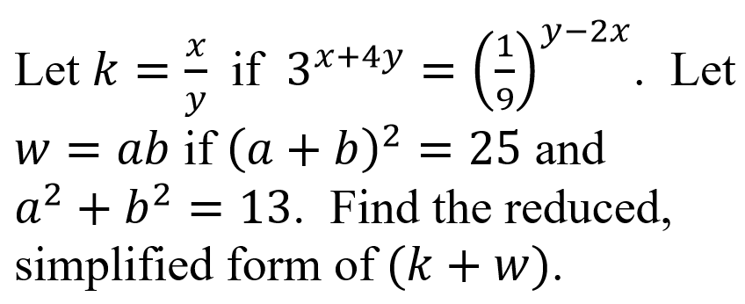
Question 1 (NO CALCULATORS)

Slide 6
Question 1 (Answer)
8

Slide 7
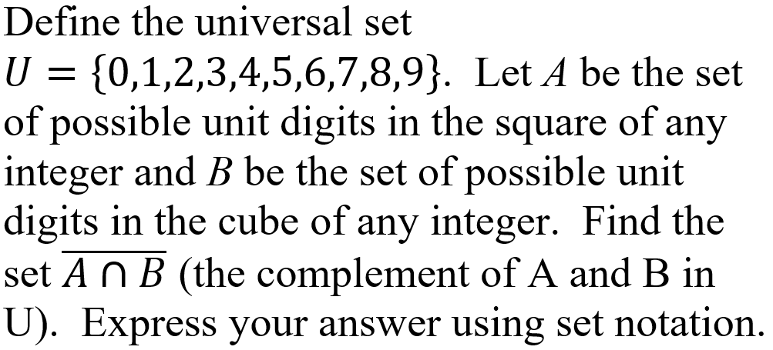
Question 2 (NO CALCULATORS)

Slide 9
Question 2 (Answer)
{2,3,7,8}

Slide 10
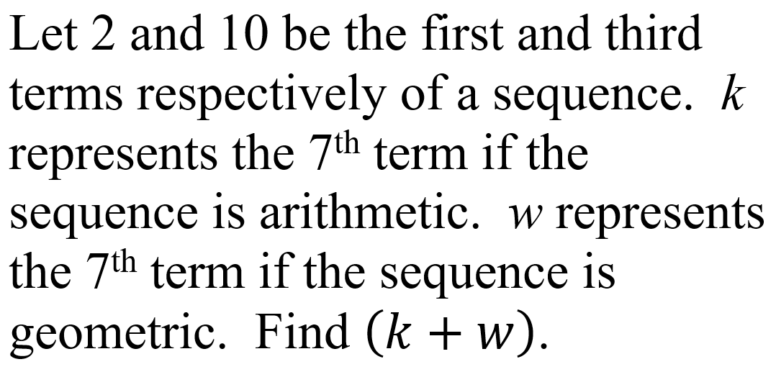
Question 3 (NO CALCULATORS)

Slide 12
Question 3 (Answer)
276

Slide 13
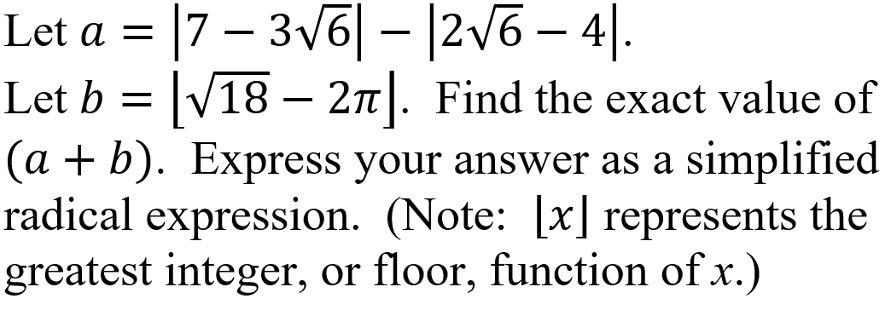
Question 4 (NO CALCULATORS)

Slide 15
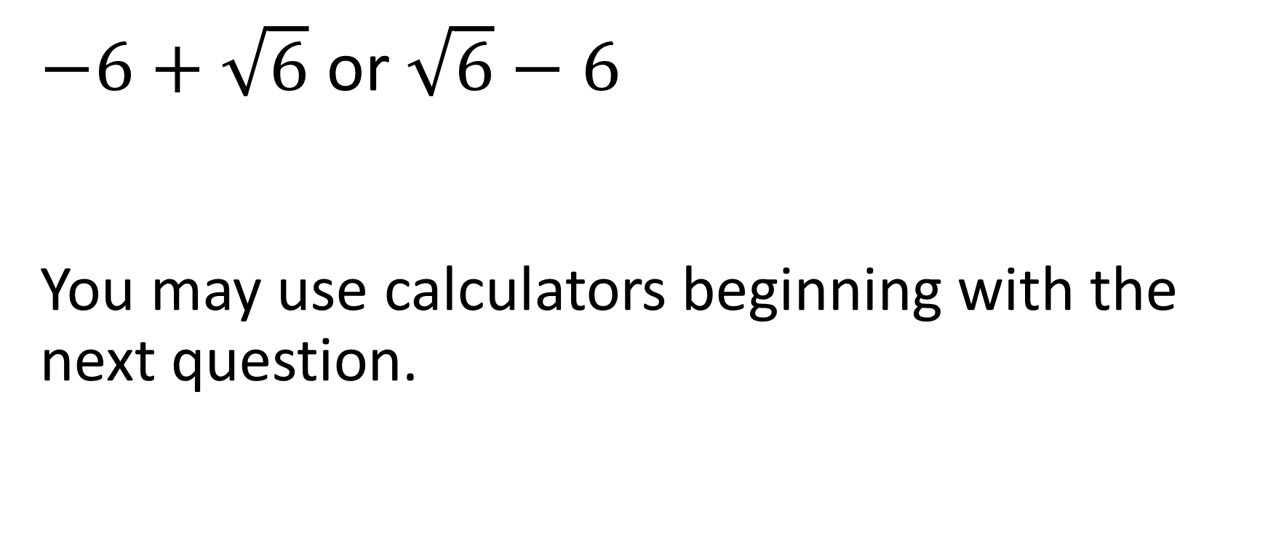
Question 4 (Answer)
$−6+\sqrt{6}$ or $\sqrt{6}−6$
You may use calculators beginning with the next question.

Slide 16
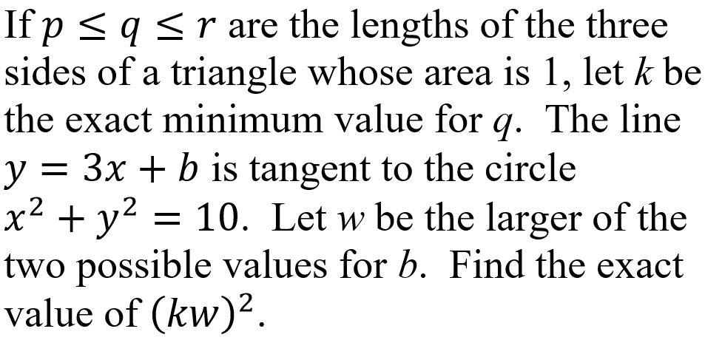
Question 5 (CALCULATORS ALLOWED)

Slide 18
Question 5 (Answer)
200

Slide 19
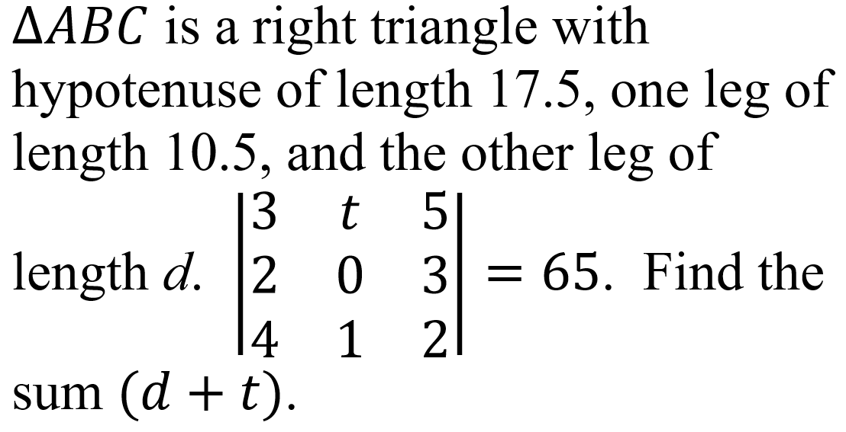
Question 6 (CALCULATORS ALLOWED)

Slide 21
Question 6 (Answer)
22

Slide 22
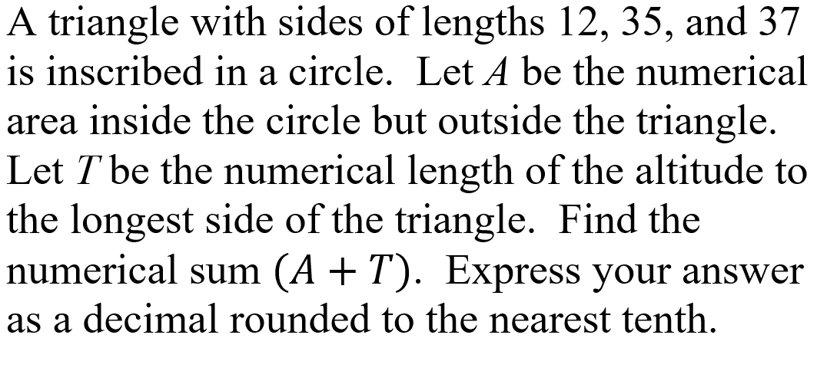
Question 7 (CALCULATORS ALLOWED)

Slide 24
Question 7 (Answer)
876.6

Slide 25
Question 8 will be the final question. Proctors will keep and total your answer sheets after you submit this question.
Please remain in your seats until totals have been verified, as ties among the top three positions would be broken with tie-breaker questions.

Slide 26
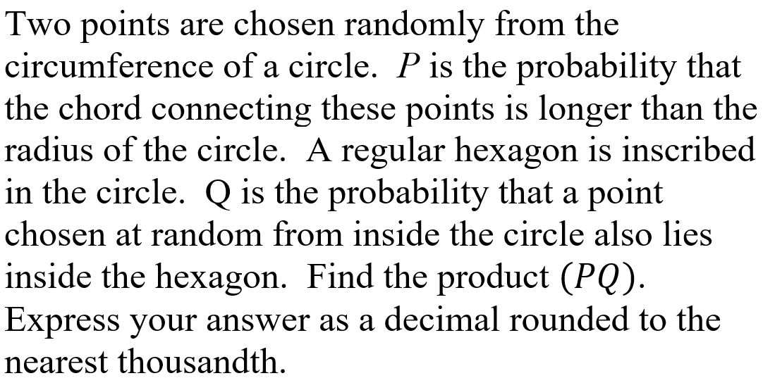
Question 8 (CALCULATORS ALLOWED)

Slide 28
Question 8 (Answer)
0.551
This ends the competition unless there are ties; please remain while proctors total the scores.

Slide 29
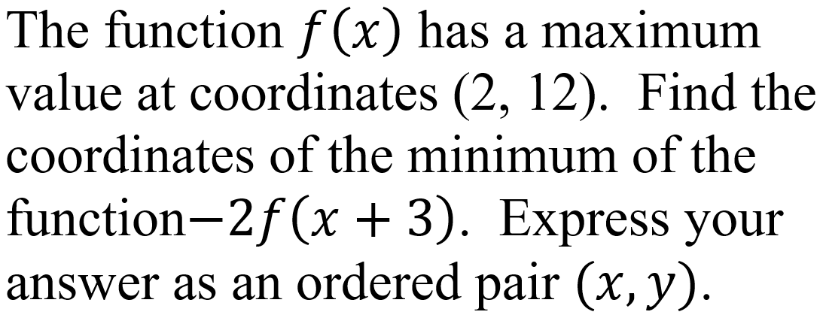
Tiebreaker 1 (CALCULATORS ALLOWED)

Slide 31
Question T1 (Answer)
(-1, -24)

Slide 32
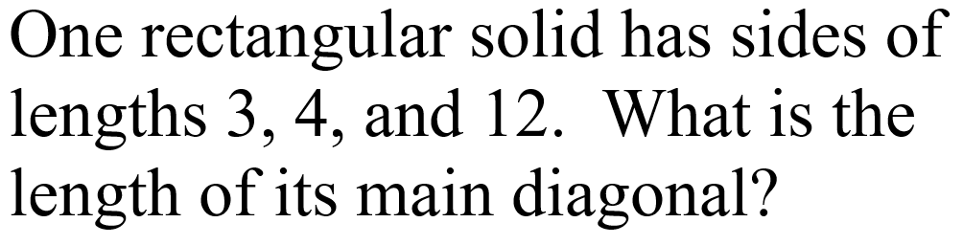
Tiebreaker 2 (CALCULATORS ALLOWED)

Slide 34
Question T2 (Answer)
13

