Slide 1


Slide 2


Slide 3
Basic Rules
Eight Questions; Three Minutes Each
NO CALCULATORS on the First Four Questions!
One Answer Submission Allowed Per Question; To Submit, Fold Answer Sheet and Hold Above Your Head for the Proctor; Answer must be submitted within 5 seconds of timer in order to count.
Scoring (Each Problem)
  First Correct Answer = 7 points
  Second Correct Answer = 5 points
  All Other Correct Answers = 3 points

Slide 4

The Next Slide Begins The Competition.
This is a timer example:

Slide 5
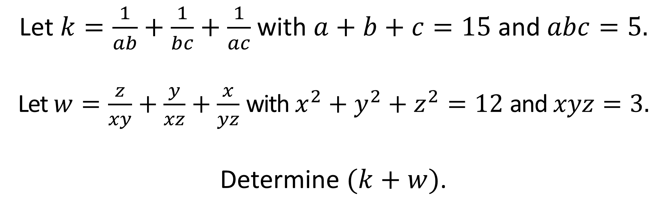
Question 1 (NO CALCULATORS)
Let $k=\frac{1}{ab}+\frac{1}{bc}+\frac{1}{ac}$ with $a+b+c=15$ and $abc=5.$
Let $w=\frac{z}{xy}+\frac{y}{xz}+\frac{x}{yz}$ with $x^{2}+y^{2}+z^{2}=12$ and $xyz=3.$
Determine $(k+w)$.

Slide 7
Question 1 (Answer)
7

Slide 8
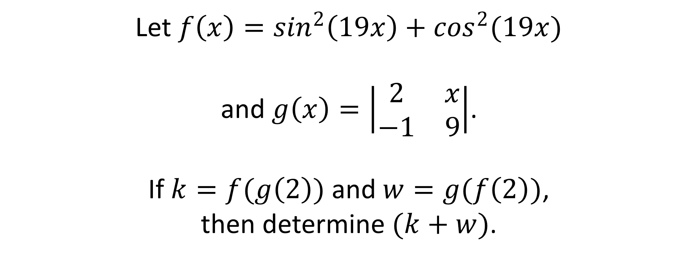
Question 2 (NO CALCULATORS)
Let $f\left(x\right)=\sin^{2}\left(19x\right)+\cos^{2}(19x)$
and $g\left(x\right)=\left|\begin{matrix}2 & x \\ −1 & 9\end{matrix}\right|$.
If $k=f(g\left(2\right))$ and $w=g(f\left(2\right))$,
then determine $(k+w)$.

Slide 10
Question 2 (Answer)
20

Slide 11
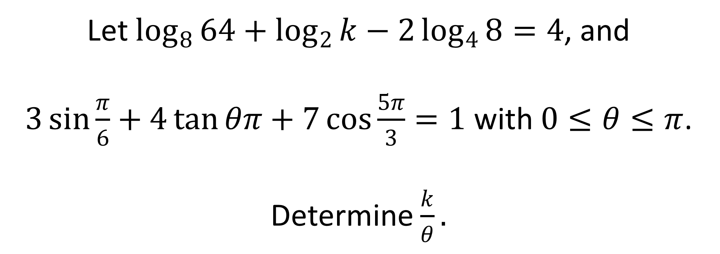
Question 3 (NO CALCULATORS)
Let $\log_{8}{64}+\log_{2}{k}−2\log_{4}{8}=4$, and
$3\sin{\frac{π}{6}}+4\tan{θπ}+7\cos{\frac{5π}{3}}=1$ with $0≤θ≤π$.
Determine $\frac{k}{θ}.$

Slide 13
Question 3 (Answer)
24

Slide 14
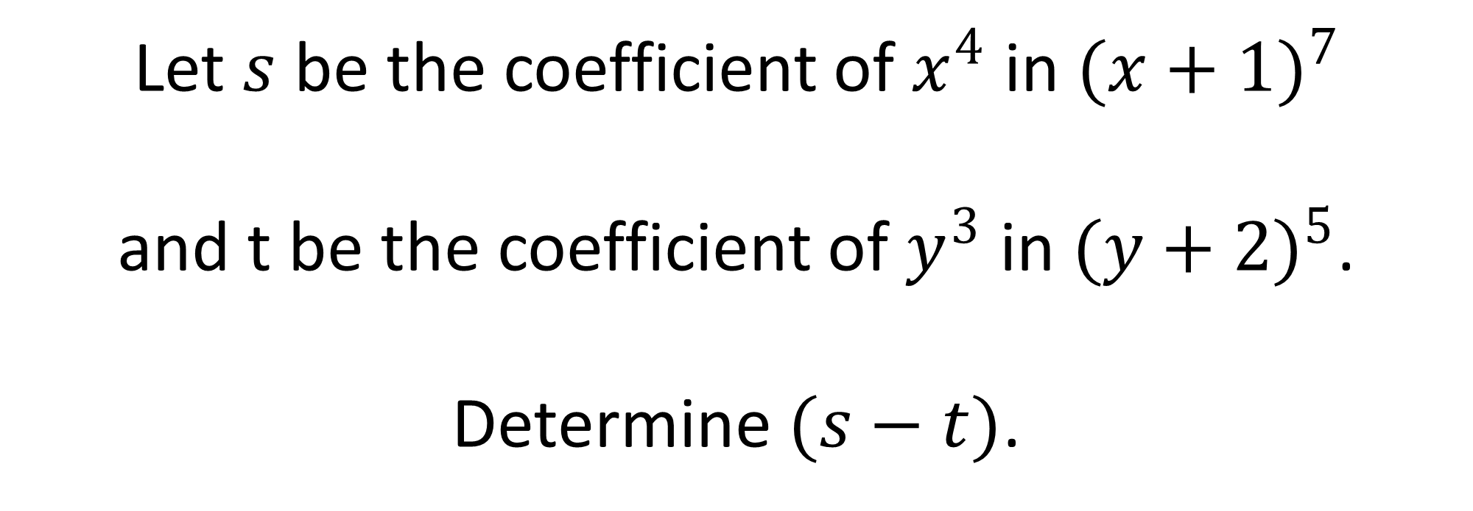
Question 4 (NO CALCULATORS)
Let $s$ be the coefficient of $x^{4}$ in ${(x+1)}^{7}$
and t be the coefficient of $y^{3}$ in ${(y+2)}^{5}$.
Determine $(s−t)$.

Slide 16

Question 4 (Answer)
$$−5$$
You may use calculators beginning with the next question.

Slide 17
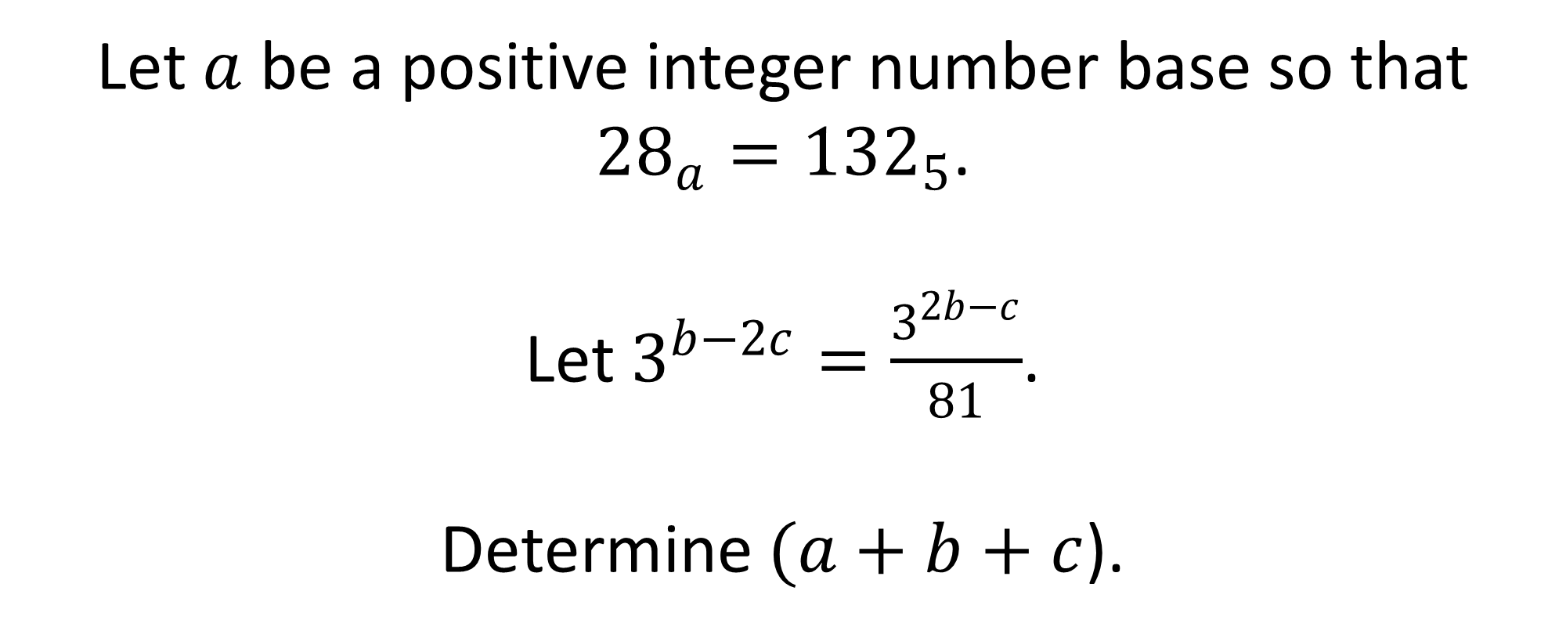
Question 5 (CALCULATORS ALLOWED)
Let $a$ be a positive integer number base so that ${28}_{a}={132}_{5}$.
Let $3^{b−2c}=\frac{3^{2b−c}}{81}$.
Determine $(a+b+c$).

Slide 19
Question 5 (Answer)
21

Slide 20
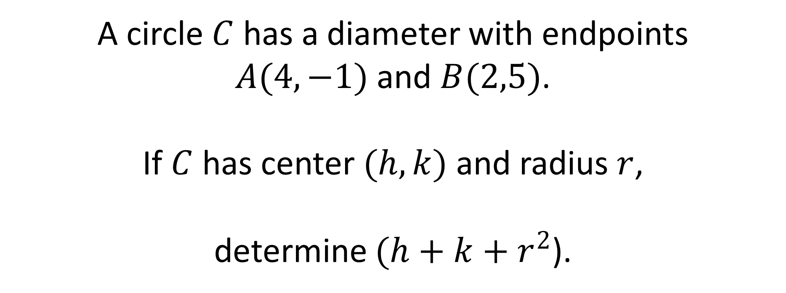
Question 6 (CALCULATORS ALLOWED)
A circle $C$ has a diameter with endpoints
$A(4,−1)$ and $B(2,5)$.
If $C$ has center $(h,k)$ and radius $r$,
determine $(h+k+r^{2}$).

Slide 22
Question 6 (Answer)
15

Slide 23
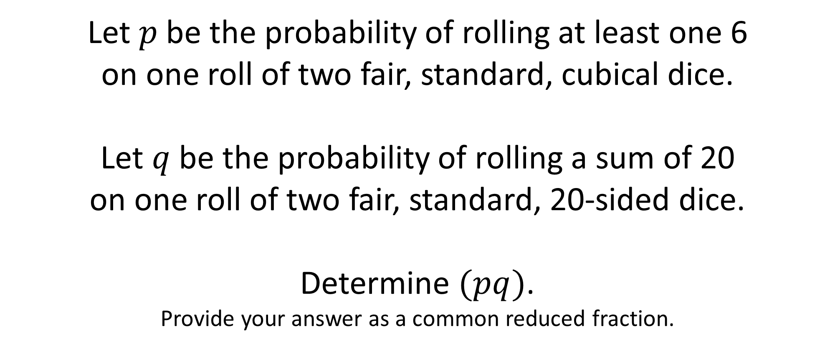
Question 7 (CALCULATORS ALLOWED)
Let $p$ be the probability of rolling at least one 6
on one roll of two fair, standard, cubical dice.
Let $q$ be the probability of rolling a sum of 20
on one roll of two fair, standard, 20-sided dice.
Determine $(pq)$.
Provide your answer as a common reduced fraction.

Slide 25
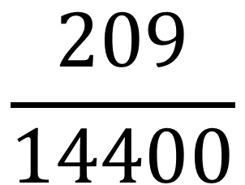
Question 7 (Answer)
$$\frac{209}{14400}$$

Slide 26
Question 8 will be the final question. Proctors will keep and total your answer sheets after you submit this question.
Please remain in your seats until totals have been verified, as ties among the top three positions would be broken with tie-breaker questions.

Slide 27
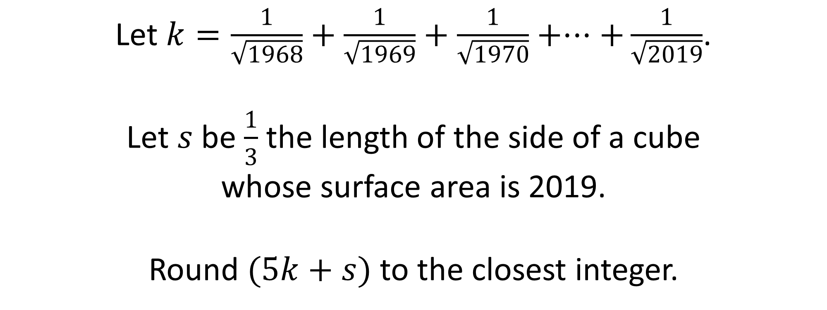
Question 8 (CALCULATORS ALLOWED)
Let $k=\frac{1}{\sqrt{1968}}+\frac{1}{\sqrt{1969}}+\frac{1}{\sqrt{1970}}+⋅⋅⋅+\frac{1}{\sqrt{2019}}$.
Let $s$ be $\frac{1}{3}$ the length of the side of a cube
whose surface area is 2019.
Round $(5k+s)$ to the closest integer.

Slide 29
Question 8 (Answer)
12
This ends the competition unless there are ties; please remain while proctors total the scores.

Slide 31
Tie-Breakers
Only teams involved in tie for any of the top three positions will participate.
If tie is not broken after two rounds because no correct answers are submitted, then the result will remain a tie.
Tie-breaking questions will not count toward a team’s overall score.

Slide 32
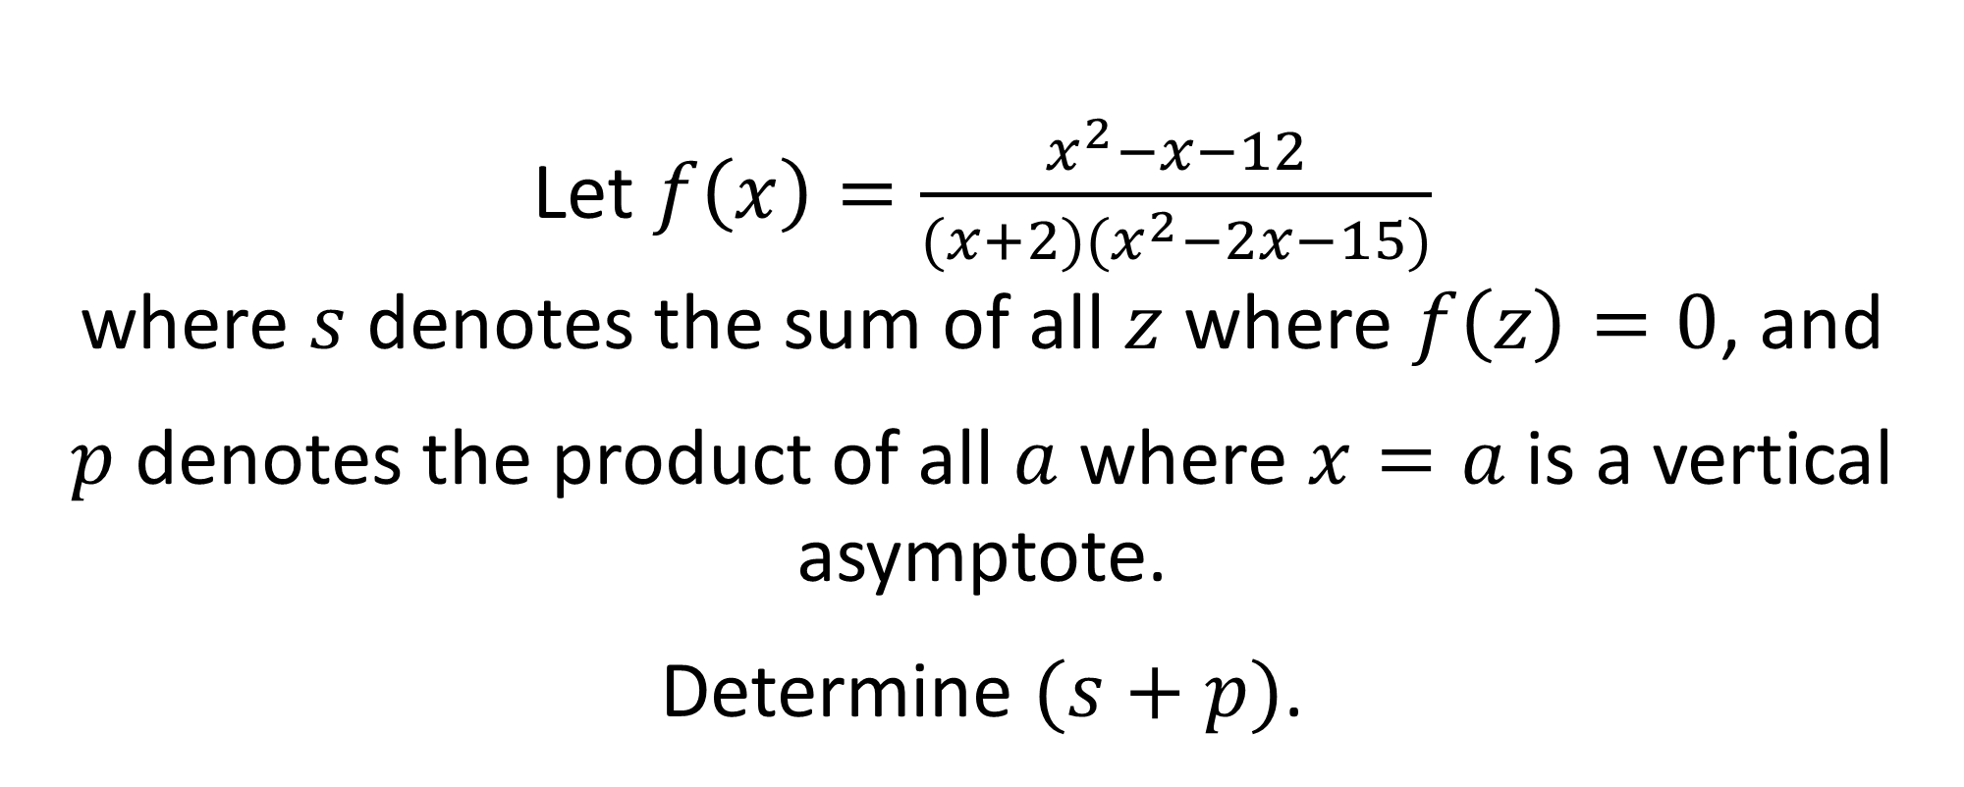
Tiebreaker 1 (CALCULATORS ALLOWED)
Let $f\left(x\right)=\frac{x^{2}−x−12}{(x+2)(x^{2}−2x−15)}$
where $s$ denotes the sum of all $z$ where $f\left(z\right)=0$, and
$p$ denotes the product of all $a$ where $x=a$ is a vertical asymptote.
Determine $(s+p)$.

Slide 34
Question T1 (Answer)
-6

Slide 35
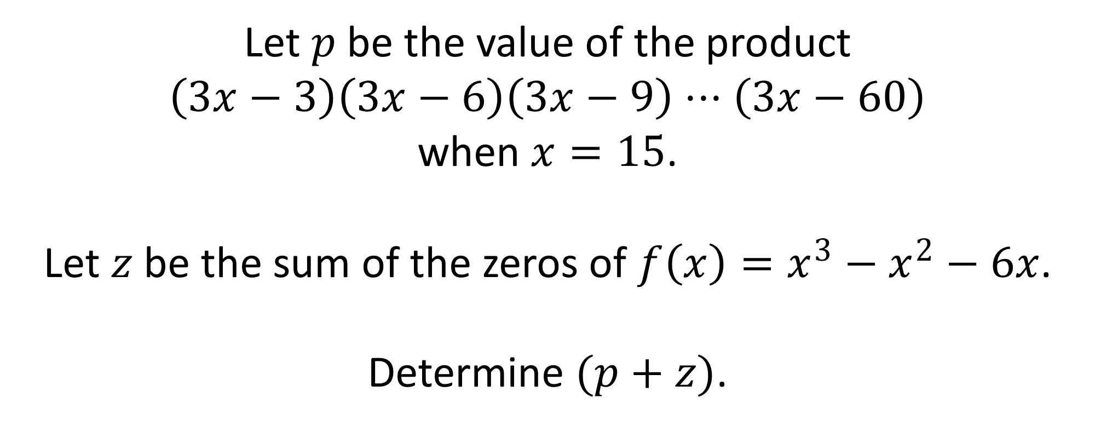
Tiebreaker 2 (CALCULATORS ALLOWED)
Let $p$ be the value of the product
$$\left(3x−3\right)\left(3x−6\right)\left(3x−9\right)⋅⋅⋅\left(3x−60\right)$$
when $x=15$.
Let $z$ be the sum of the zeros of $f\left(x\right)=x^{3}−x^{2}−6x$.
Determine $(p+z)$.

Slide 37
Question T2 (Answer)
1

