Slide 1
30th Annual
John O’Bryan
Mathematics Contest
Two-Person Speed Competition

Slide 2
Basic Rules
Eight Questions; Three Minutes Each
NO CALCULATORS on the First Four Questions!
One Answer Submission Allowed Per Question; To Submit, Fold Answer Sheet and Hold Above Your Head for the Proctor; Answer must be submitted within 5 seconds of timer in order to count.
Scoring (Each Problem)
  First Correct Answer = 7 points
  Second Correct Answer = 5 points
  All Other Correct Answers = 3 points

Slide 3

The Next Slide Begins The Competition.
This is a timer example:

Slide 4
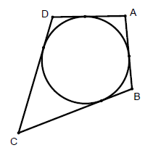
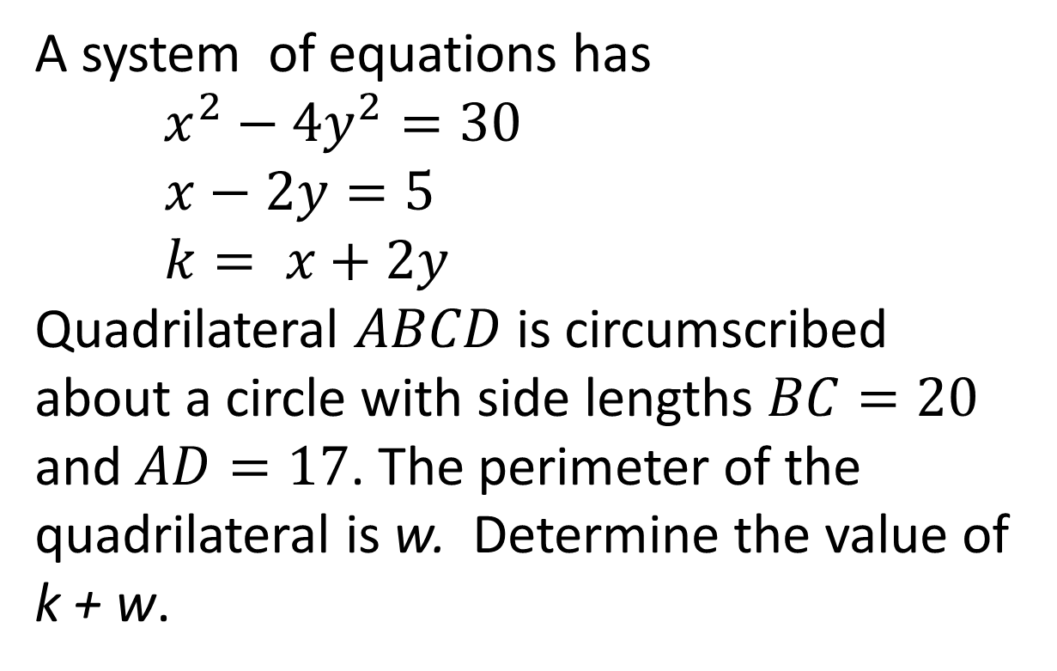
Question 1 (NO CALCULATORS)
A system of equations has
$x^{2}−4y^{2}=30$
$x−2y=5$
$k= x+2y$
Quadrilateral $ABCD$ is circumscribed about a circle with side lengths $BC=20$ and $AD=17$. The perimeter of the quadrilateral is w. Determine the value of k + w.

Slide 6
Question 1 (Answer)
80

Slide 7
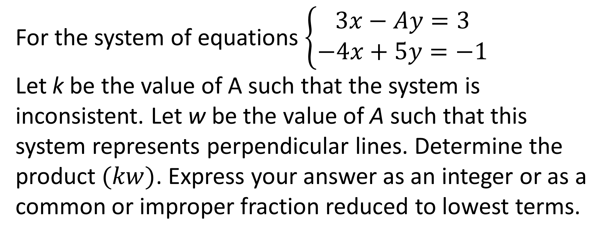
Question 2 (NO CALCULATORS)
For the system of equations $\left\{\begin{aligned}3x−Ay=3 \\ −4x+5y=−1\end{aligned}\right.$
Let k be the value of A such that the system is inconsistent. Let w be the value of A such that this system represents perpendicular lines. Determine the product $(kw)$. Express your answer as an integer or as a common or improper fraction reduced to lowest terms.

Slide 9
Question 2 (Answer)
-9

Slide 10
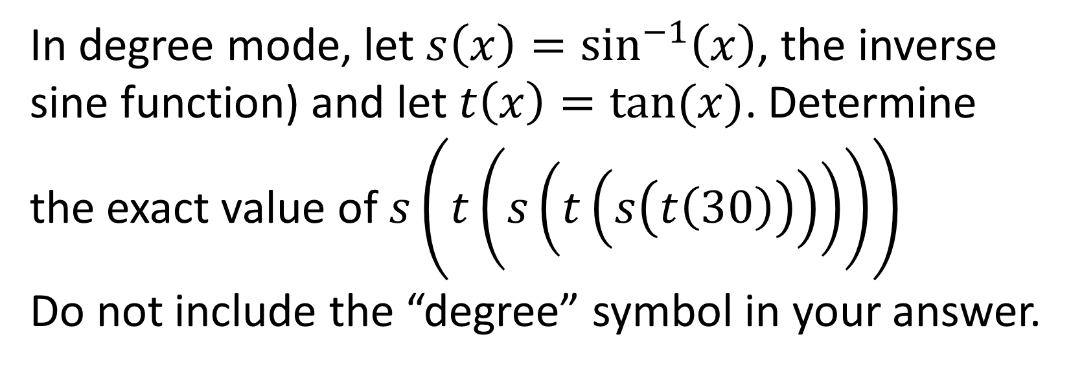
Question 3 (NO CALCULATORS)
In degree mode, let $s\left(x\right)=\sin^{−1}\left(x\right)$, the inverse sine function) and let $t\left(x\right)=tan⁡(x)$. Determine the exact value of $s\left(t\left(s\left(t\left(s\left(t\left(30\right)\right)\right)\right)\right)\right)$
Do not include the “degree” symbol in your answer.

Slide 12
Question 3 (Answer)
90

Slide 13
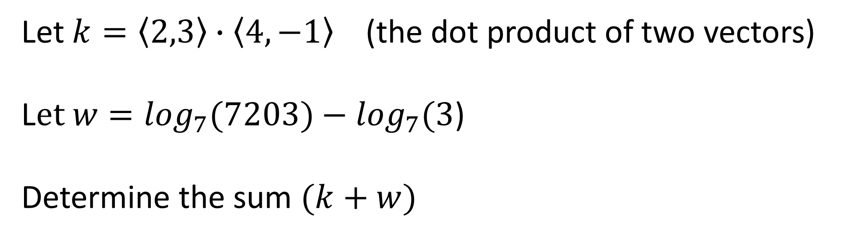
Question 4 (NO CALCULATORS)
Let $k=〈2,3〉∙〈4,−1〉$ (the dot product of two vectors)
L$et w=\log_{7}(7203)−\log_{7}(3$)
Determine the sum $(k+w)$

Slide 15
Question 4 (Answer)
9
You may use calculators beginning with the next question.

Slide 16
Question 5 (CALCULATORS ALLOWED)
The sum of the lengths of two legs of a right triangle is 49. The square of the numeric length of the hypotenuse is 1225. Determine the numeric area of this triangle.

Slide 18
Question 5 (Answer)
294

Slide 19
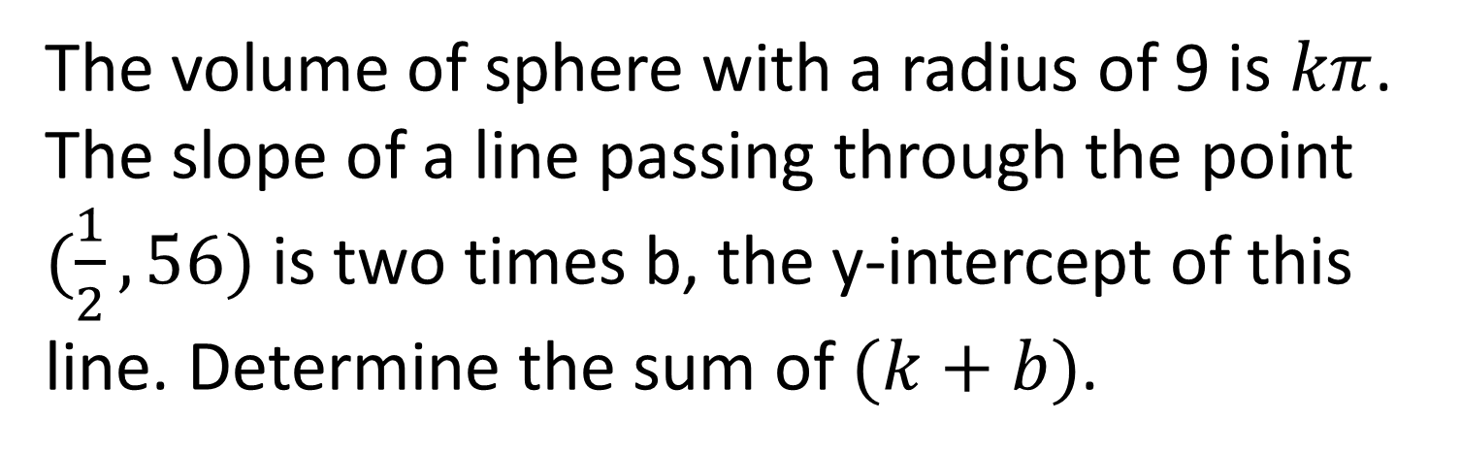
Question 6 (CALCULATORS ALLOWED)
The volume of sphere with a radius of 9 is $kπ$. The slope of a line passing through the point $(\frac{1}{2},56)$ is two times b, the y-intercept of this line. Determine the sum of $(k+b)$.

Slide 21
Question 6 (Answer)
1000

Slide 22
Question 7 (CALCULATORS ALLOWED)
Hailey and Jay each toss a fair coin 5 times. Determine the probability that Hailey tossed at least 3 more heads then Jay. Express your answer as a common fraction reduced to lowest terms.

Slide 24
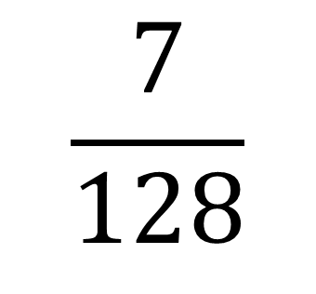
Question 7 (Answer)
$$\frac{7}{128}$$

Slide 25
Question 8 will be the final question. Proctors will keep and total your answer sheets after you submit this question.
Please remain in your seats until totals have been verified, as ties among the top three positions would be broken with tie-breaker questions.

Slide 26
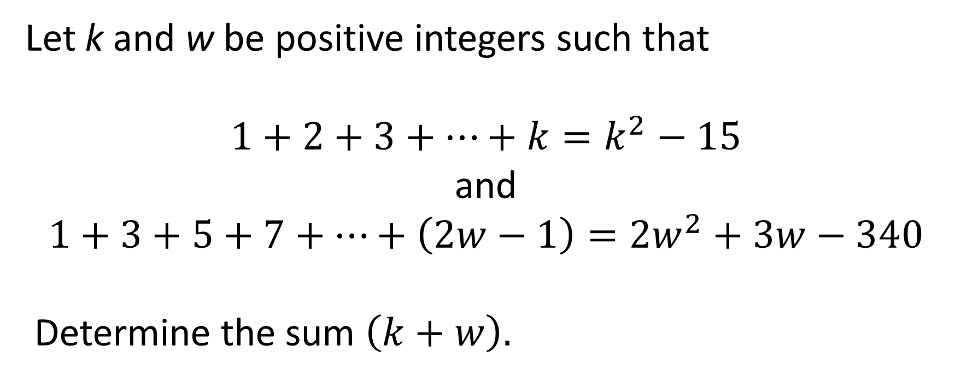
Question 8 (CALCULATORS ALLOWED)
Let k and w be positive integers such that
$$1+2+3+…+k=k^{2}−15$$
and
$$1+3+5+7+…+\left(2w−1\right)=2w^{2}+3w−340$$
Determine the sum $\left(k+w\right).$

Slide 28
Question 8 (Answer)
23
This ends the competition unless there are ties; please remain while proctors total the scores.

Slide 30
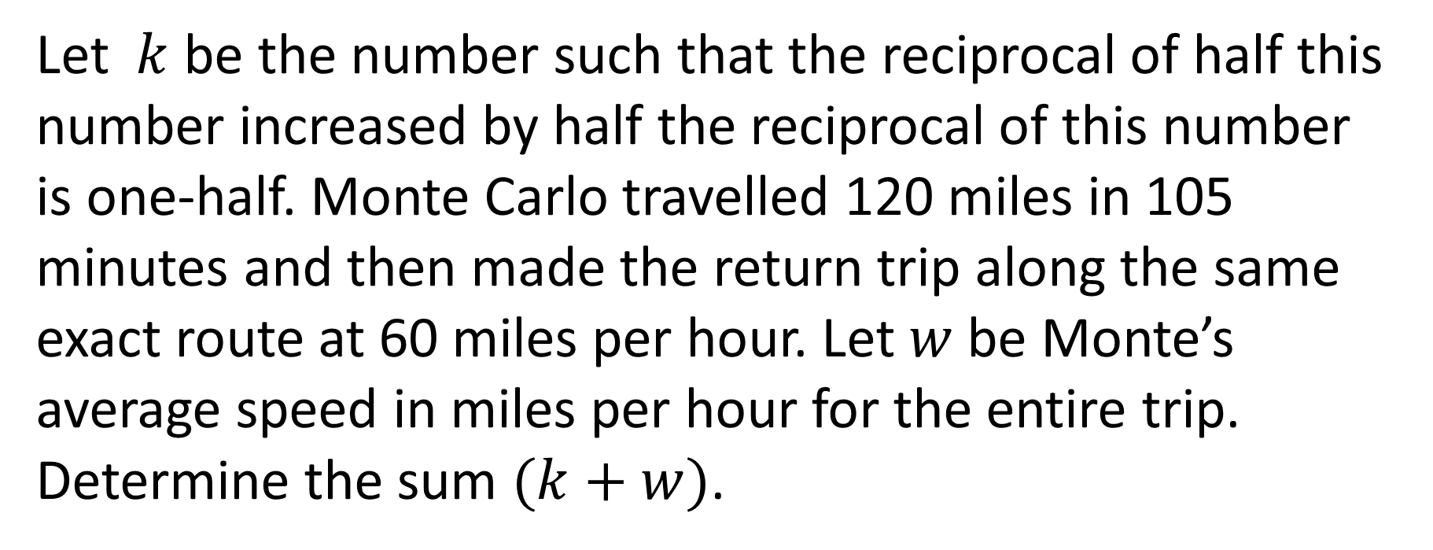
Tiebreaker 1 (CALCULATORS ALLOWED)
Let $k$ be the number such that the reciprocal of half this number increased by half the reciprocal of this number is one-half. Monte Carlo travelled 120 miles in 105 minutes and then made the return trip along the same exact route at 60 miles per hour. Let $w$ be Monte’s average speed in miles per hour for the entire trip. Determine the sum $(k+w)$.

Slide 32
Question T1 (Answer)
69

Slide 33
Tiebreaker 2 (CALCULATORS ALLOWED)
One dozen more than two dozen score, plus six times the square root of four. Divide that by seven, add three times eleven, get nine square and just a bit more. Determine how much more. Note: One score is 20 .

Slide 35
Question T2 (Answer)
24

