Slide 1
30th Annual
John O’Bryan
Mathematics Contest
Two-Person Speed Competition

Slide 2
Basic Rules
Eight Questions; Three Minutes Each
NO CALCULATORS on the First Four Questions!
One Answer Submission Allowed Per Question; To Submit, Fold Answer Sheet and Hold Above Your Head for the Proctor; Answer must be submitted within 5 seconds of timer in order to count.
Scoring (Each Problem)
  First Correct Answer = 7 points
  Second Correct Answer = 5 points
  All Other Correct Answers = 3 points

Slide 3

The Next Slide Begins The Competition.
This is a timer example:

Slide 4
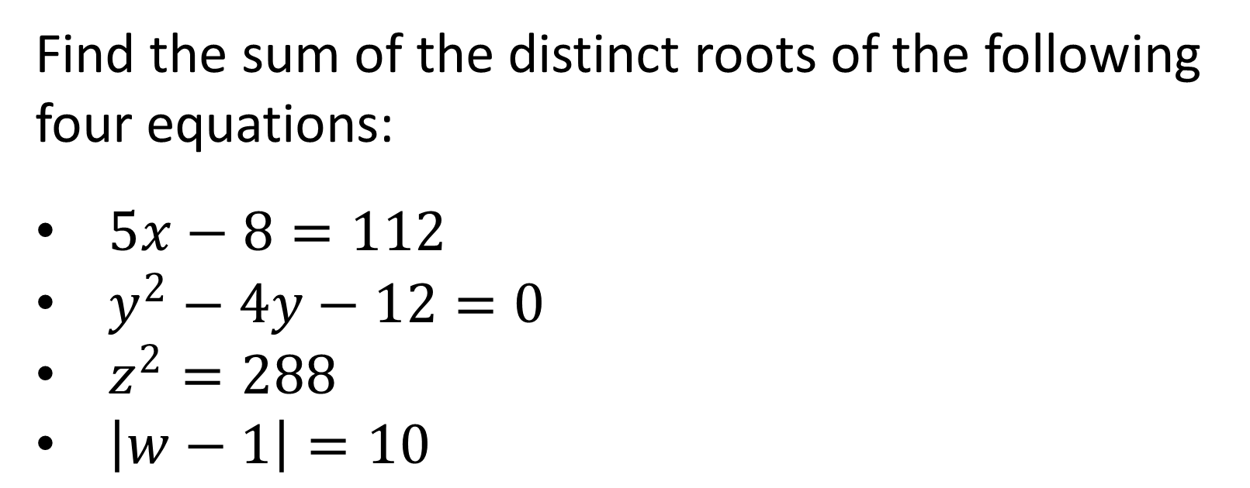
Question 1 (NO CALCULATORS)
Find the sum of the distinct roots of the following four equations:
$5x−8=112$
$y^{2}−4y−12=0$
$z^{2}=288$
$\left|w−1\right|=10$

Slide 6
Question 1 (Answer)
30

Slide 7
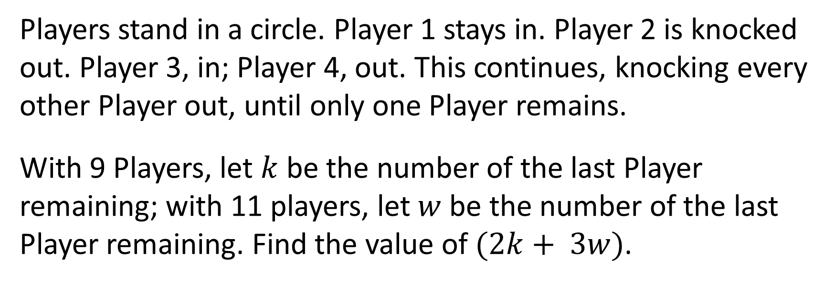
Question 2 (NO CALCULATORS)
Players stand in a circle. Player 1 stays in. Player 2 is knocked out. Player 3, in; Player 4, out. This continues, knocking every other Player out, until only one Player remains.
With 9 Players, let $k$ be the number of the last Player remaining; with 11 players, let $w$ be the number of the last Player remaining. Find the value of $(2k+ 3w)$.

Slide 9
Question 2 (Answer)
27

Slide 10
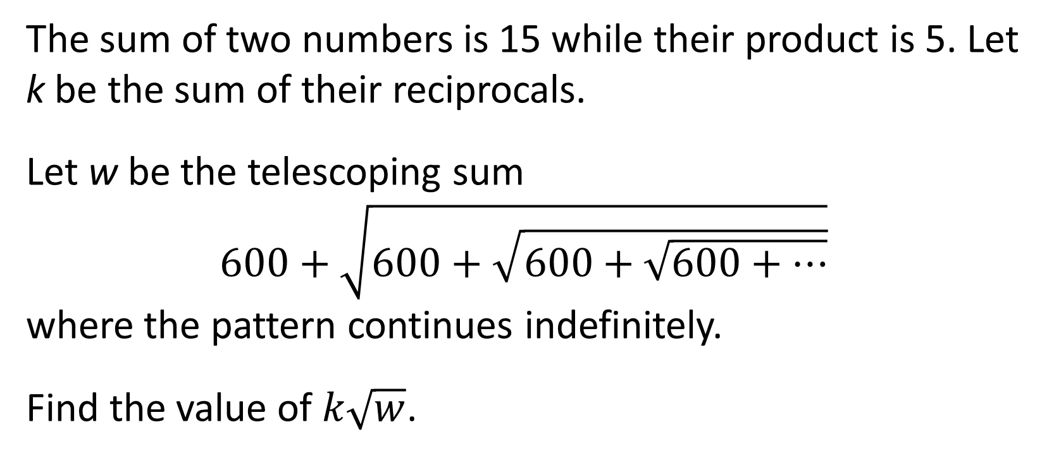
Question 3 (NO CALCULATORS)
The sum of two numbers is 15 while their product is 5. Let k be the sum of their reciprocals.
Let w be the telescoping sum
$600+\sqrt{600+\sqrt{600+\sqrt{600+…}}}$
where the pattern continues indefinitely.
Find the value of $k\sqrt{w}$.

Slide 12
Question 3 (Answer)
75

Slide 13
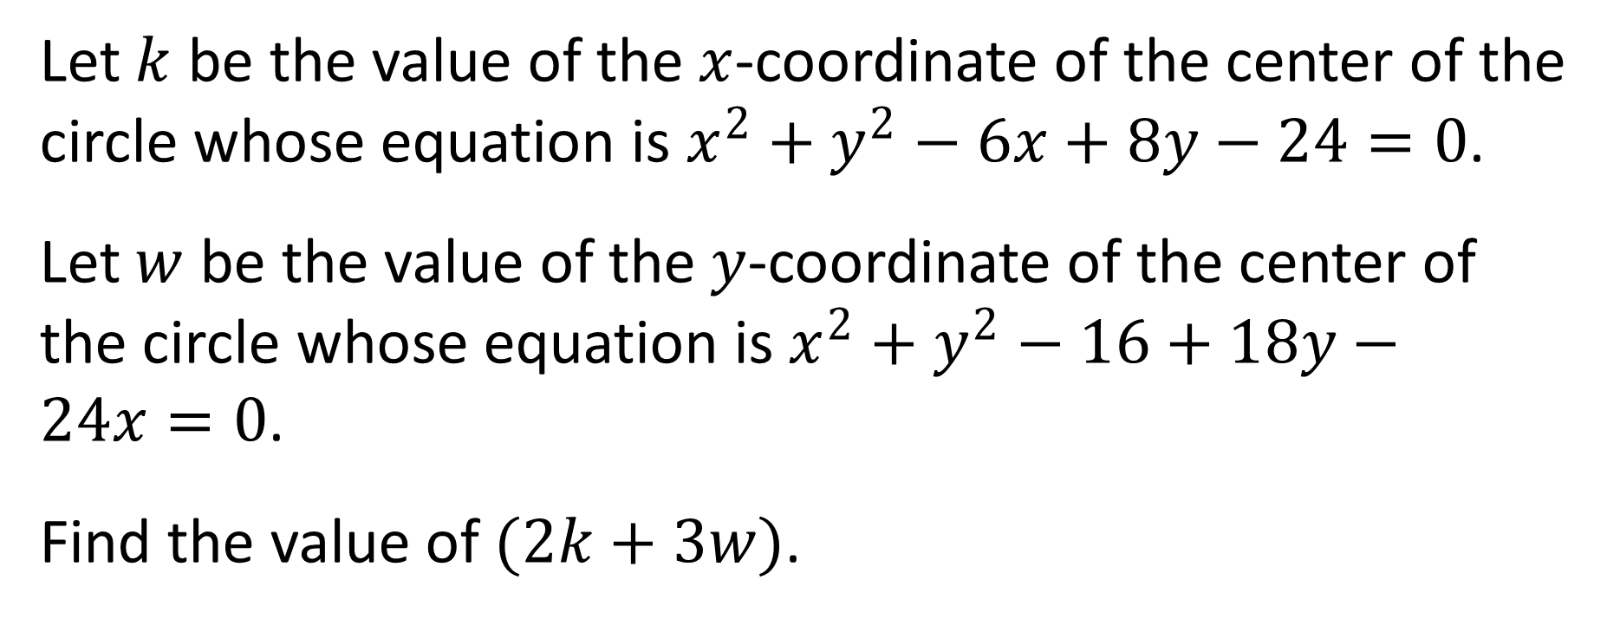
Question 4 (NO CALCULATORS)
Let $k$ be the value of the $x$-coordinate of the center of the circle whose equation is $x^{2}+y^{2}−6x+8y−24=0$.
Let $w$ be the value of the $y$-coordinate of the center of the circle whose equation is $x^{2}+y^{2}−16+18y−24x=0$.
Find the value of $(2k+3w)$.

Slide 15
Question 4 (Answer)
-21
You may use calculators beginning with the next question.

Slide 16
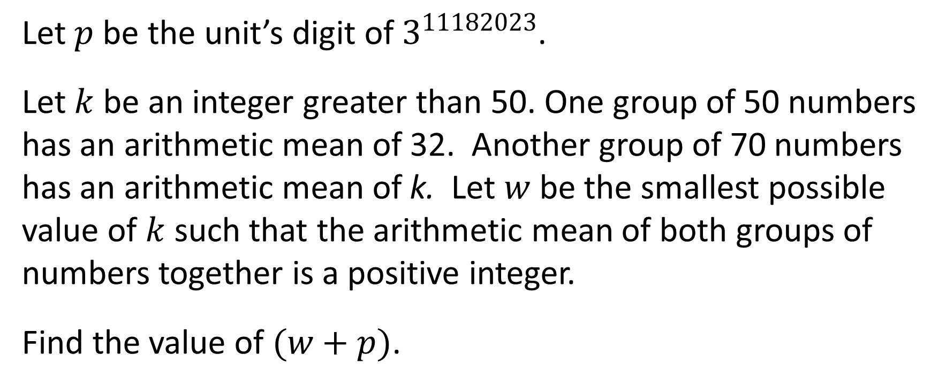
Question 5 (CALCULATORS ALLOWED)
Let $p$ be the unit’s digit of $3^{11182023}$.
Let $k$ be an integer greater than 50. One group of 50 numbers has an arithmetic mean of 32. Another group of 70 numbers has an arithmetic mean of k. Let $w$ be the smallest possible value of $k$ such that the arithmetic mean of both groups of numbers together is a positive integer.
Find the value of $(w+p)$.

Slide 18
Question 5 (Answer)
63

Slide 19
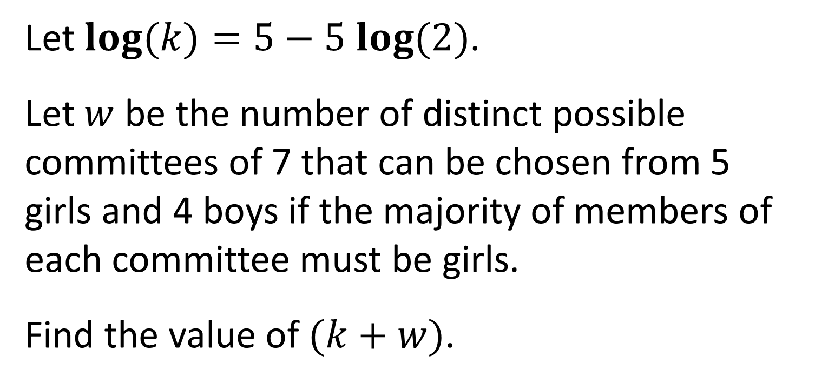
Question 6 (CALCULATORS ALLOWED)
Let $log(k)=5−5 log(2)$.
Let $w$ be the number of distinct possible committees of 7 that can be chosen from 5 girls and 4 boys if the majority of members of each committee must be girls.
Find the value of $(k+w)$.

Slide 21
Question 6 (Answer)
3151

Slide 22
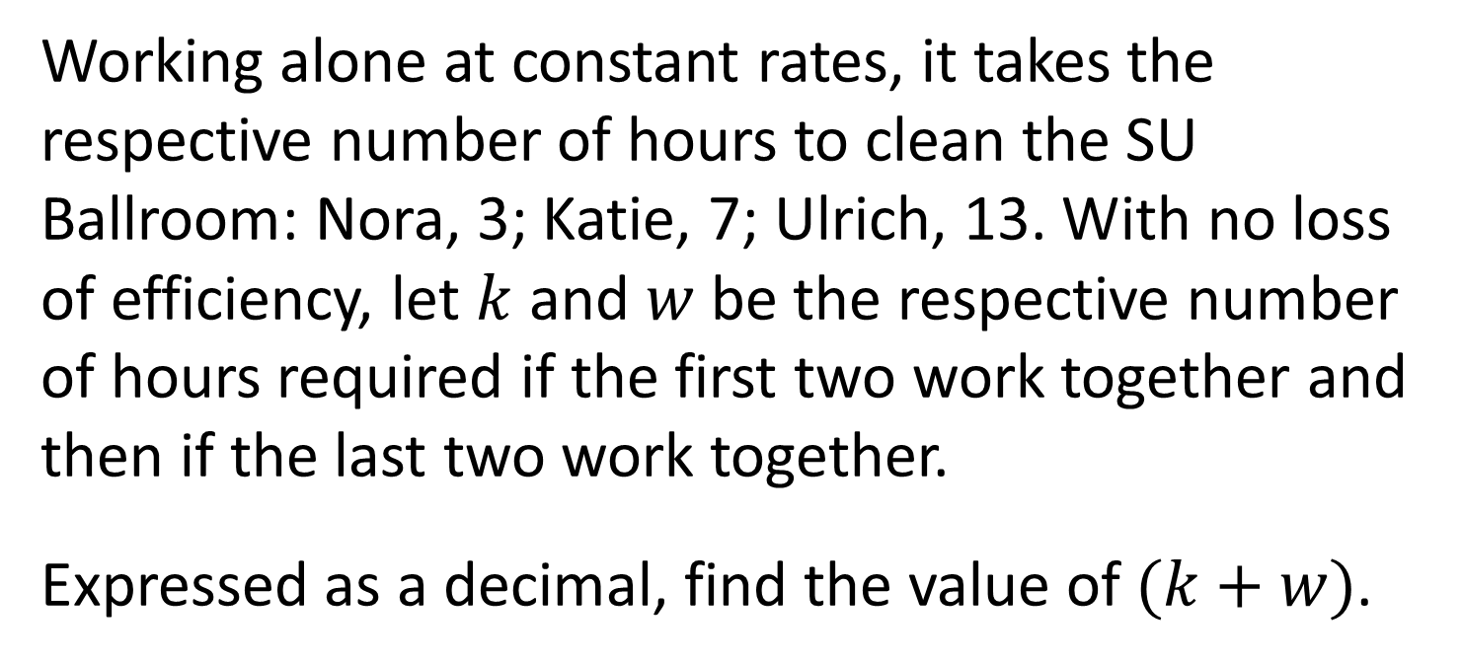
Question 7 (CALCULATORS ALLOWED)
Working alone at constant rates, it takes the respective number of hours to clean the SU Ballroom: Nora, 3; Katie, 7; Ulrich, 13. With no loss of efficiency, let $k$ and $w$ be the respective number of hours required if the first two work together and then if the last two work together.
Expressed as a decimal, find the value of $(k+w)$.

Slide 24
Question 7 (Answer)
6.65

Slide 25
Question 8 will be the final question. Proctors will keep and total your answer sheets after you submit this question.
Please remain in your seats until totals have been verified, as ties among the top three positions would be broken with tie-breaker questions.

Slide 26
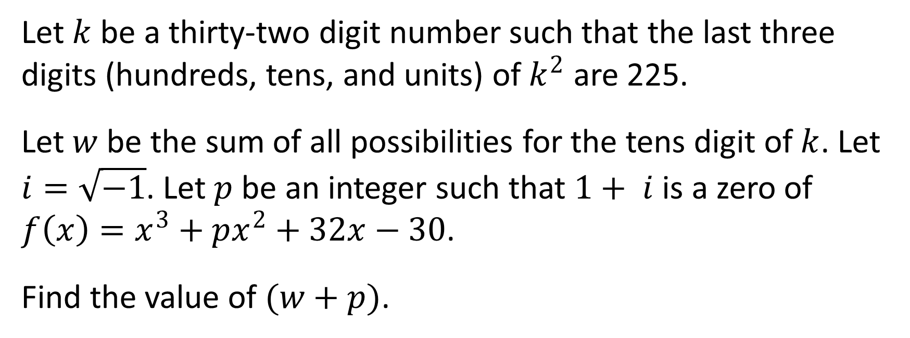
Question 8 (CALCULATORS ALLOWED)
Let $k$ be a thirty-two digit number such that the last three digits (hundreds, tens, and units) of $k^{2}$ are 225.
Let $w$ be the sum of all possibilities for the tens digit of $k$. Let $i=\sqrt{−1}$. Let $p$ be an integer such that $1+ i$ is a zero of $f\left(x\right)=x^{3}+px^{2}+32x−30$.
Find the value of $(w+p)$.

Slide 28
Question 8 (Answer)
1
This ends the competition unless there are ties; please remain while proctors total the scores.

Slide 30
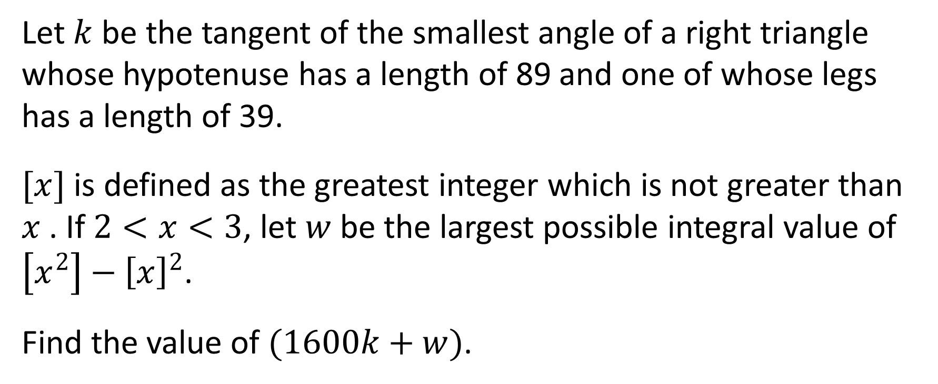
Tiebreaker 1 (CALCULATORS ALLOWED)
Let $k$ be the tangent of the smallest angle of a right triangle whose hypotenuse has a length of 89 and one of whose legs has a length of 39.
$[x]$ is defined as the greatest integer which is not greater than $x$ . If $2<x<3$, let $w$ be the largest possible integral value of $\left[x^{2}\right]−{\left[x\right]}^{2}$.
Find the value of $(1600k+w)$.

Slide 32
Question T1 (Answer)
784

Slide 33
Tiebreaker 2 (CALCULATORS ALLOWED)
Find the average of the first 50 terms of the arithmetic sequence: 7,10,13,16,….
Express your answer as an exact decimal.

Slide 35
Question T2 (Answer)
80.5

Slide 36
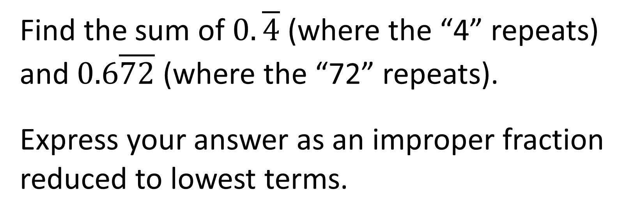
Tiebreaker 3 (CALCULATORS ALLOWED)
Find the sum of $0.\overline{4}$ (where the “4” repeats) and $0.6\overline{72}$ (where the “72” repeats).
Express your answer as an improper fraction reduced to lowest terms.

Slide 38
Question T3 (Answer)
553/495

